Slide 1

CS 533 INTRO TO DATA SCIENCE
Michael Ekstrand

Slide 2
INTRODUCTION

Slide 3
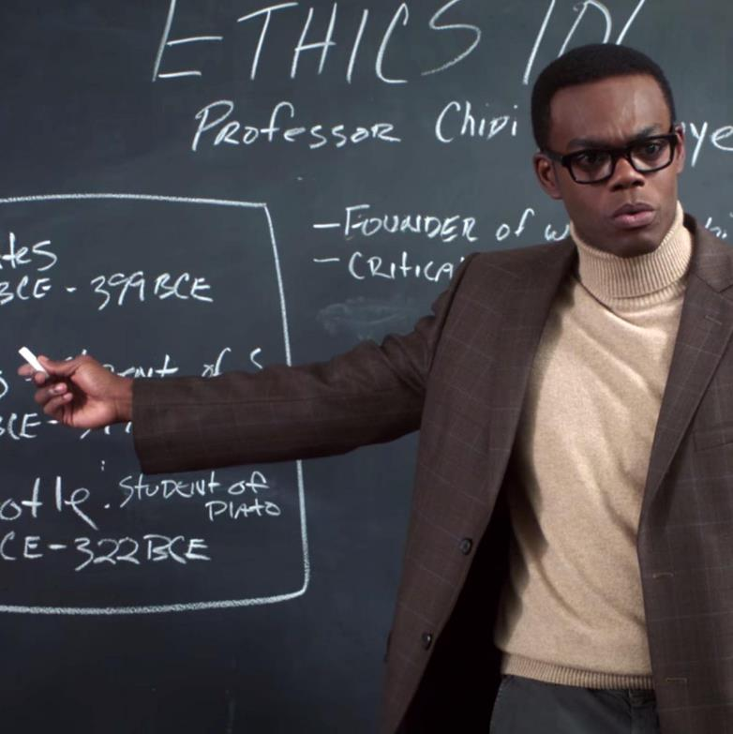
Video Outcomes
Introduce the class subject
Understand course learning outcomes
Understand structure of this class
Know where to get help

Slide 4
What is Data Science?
The use of data to provide quantitative insights on questions of scientific, business, or social interest.

Slide 5
Data and Meaning
“By itself, some piece of data has no meaning. Data is only given meaning – as evidence – by the people who make use of it.”
Sergio Sismondo, An Introduction to Science and Technology Studies, 2nd Edition. Wiley-Blackwell, 2010, page 133.

Slide 6
Learning Outcomes
Explore a data set to determine whether and how it might illuminate questions of interest.
Define and operationalize a research question such that a data analysis could produce meaningful knowledge.
Use best practices to carry out analyses in a documented, reproducible, and efficient fashion.
Present the results of a data analysis with appropriate visuals and written argument.
Identify weaknesses in a data analysis and assess their impact on the correctness and utility of the results.
Assess ethical implications of an analysis in terms of both classical human subject research ethics and contemporary concerns such as fairness and bias.
Understand the space of data science techniques and applications, and relate future learning to this framework.

Slide 7
Course Components
Videos and readings – this is the primary content delivery
Web site is your guide!
In-class meetings – application, discussion, exercises
Quiz before class on Thursday
Assignments
Exams
2 midterm + final

Slide 8
Getting Help
In-class from peers and instructor
Course forum on Piazza – encouraged!
Office hours
Remote office hours available by appointment
Please use Piazza for course inquiries
Use the Internet
Documentation and resources
Public Q&A sites (within reason)

Slide 9
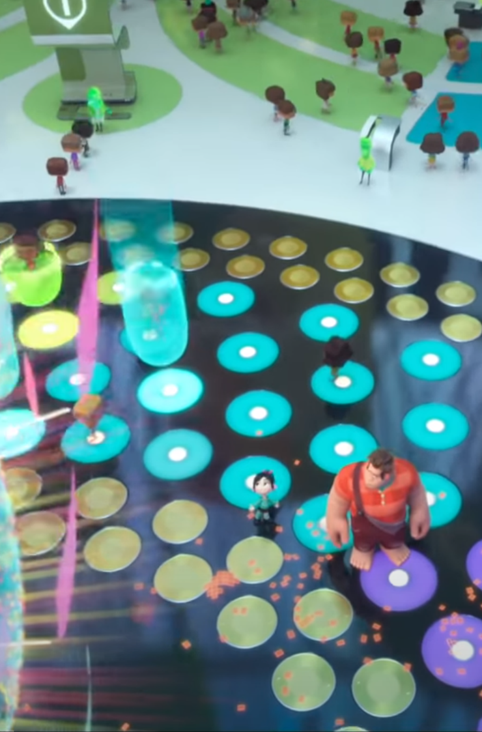
Wrapping Up
This class is designed to:
Provide flexibility in learning
Use each modality to its best advantage
to achieve our learning outcomes.
Let’s learn!
We’re in the Internet!

